Slide 1
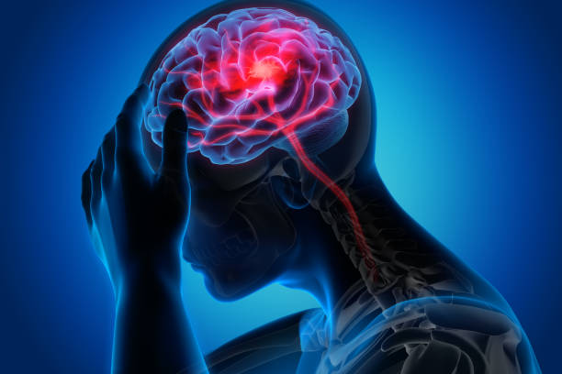
Predicting Stroke using Naive Bayes Classifier
Gaganpreet Kaur
Professor: Xinlian Liu
Date: 12/13/2021
Computer Science Department
Hood College of Frederick Maryland

Slide 2
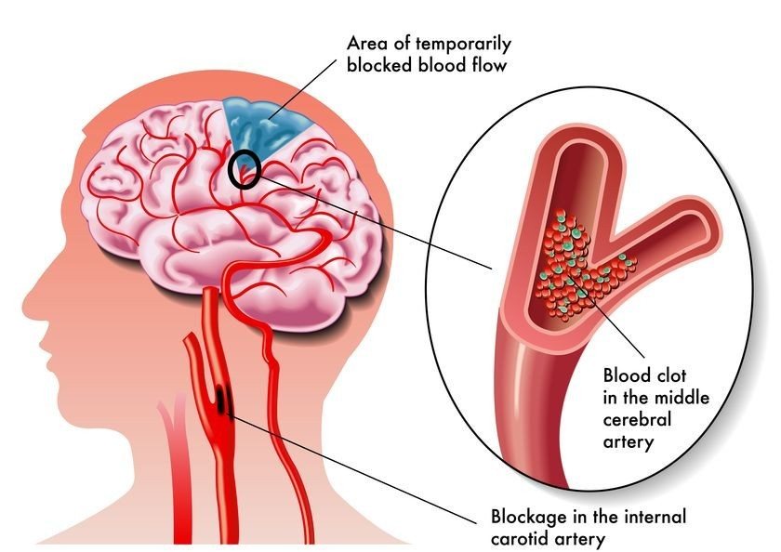
Overview
What is Stroke?
Causes of Stroke
Prevention & Treatment
ML and Stroke

Slide 3
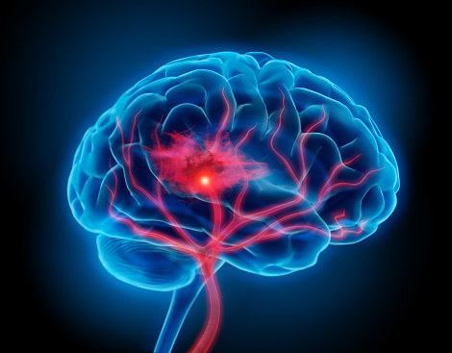
Problem
U.S:
Cases: 795,000/year
77% cases of new stroke
1 in every 6 deaths
Stroke Every 40 seconds
Death from Stroke Every 4 minutes
87% of all strokes are Ischemic Strokes
Worldwide:
Cases: 13 million/year
Deaths: 5.5 million/year
Leading cause of serious long-term disability
Stroke Reduces Mobility

Slide 4

Solution Approach
Predict Strokes using ML Algorithm
Analyze the Data
Pre-process the Data
Setup Model using Naive Bayes
Evaluate Results

Slide 5
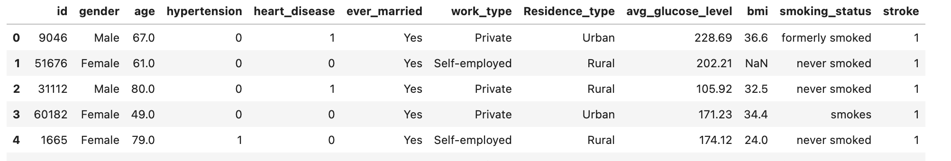
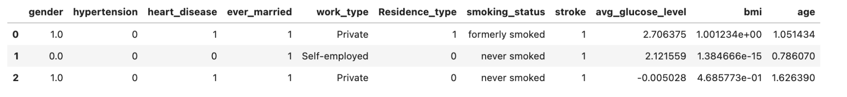
Stroke Data
Raw Data
Scrubbed Data

Slide 6
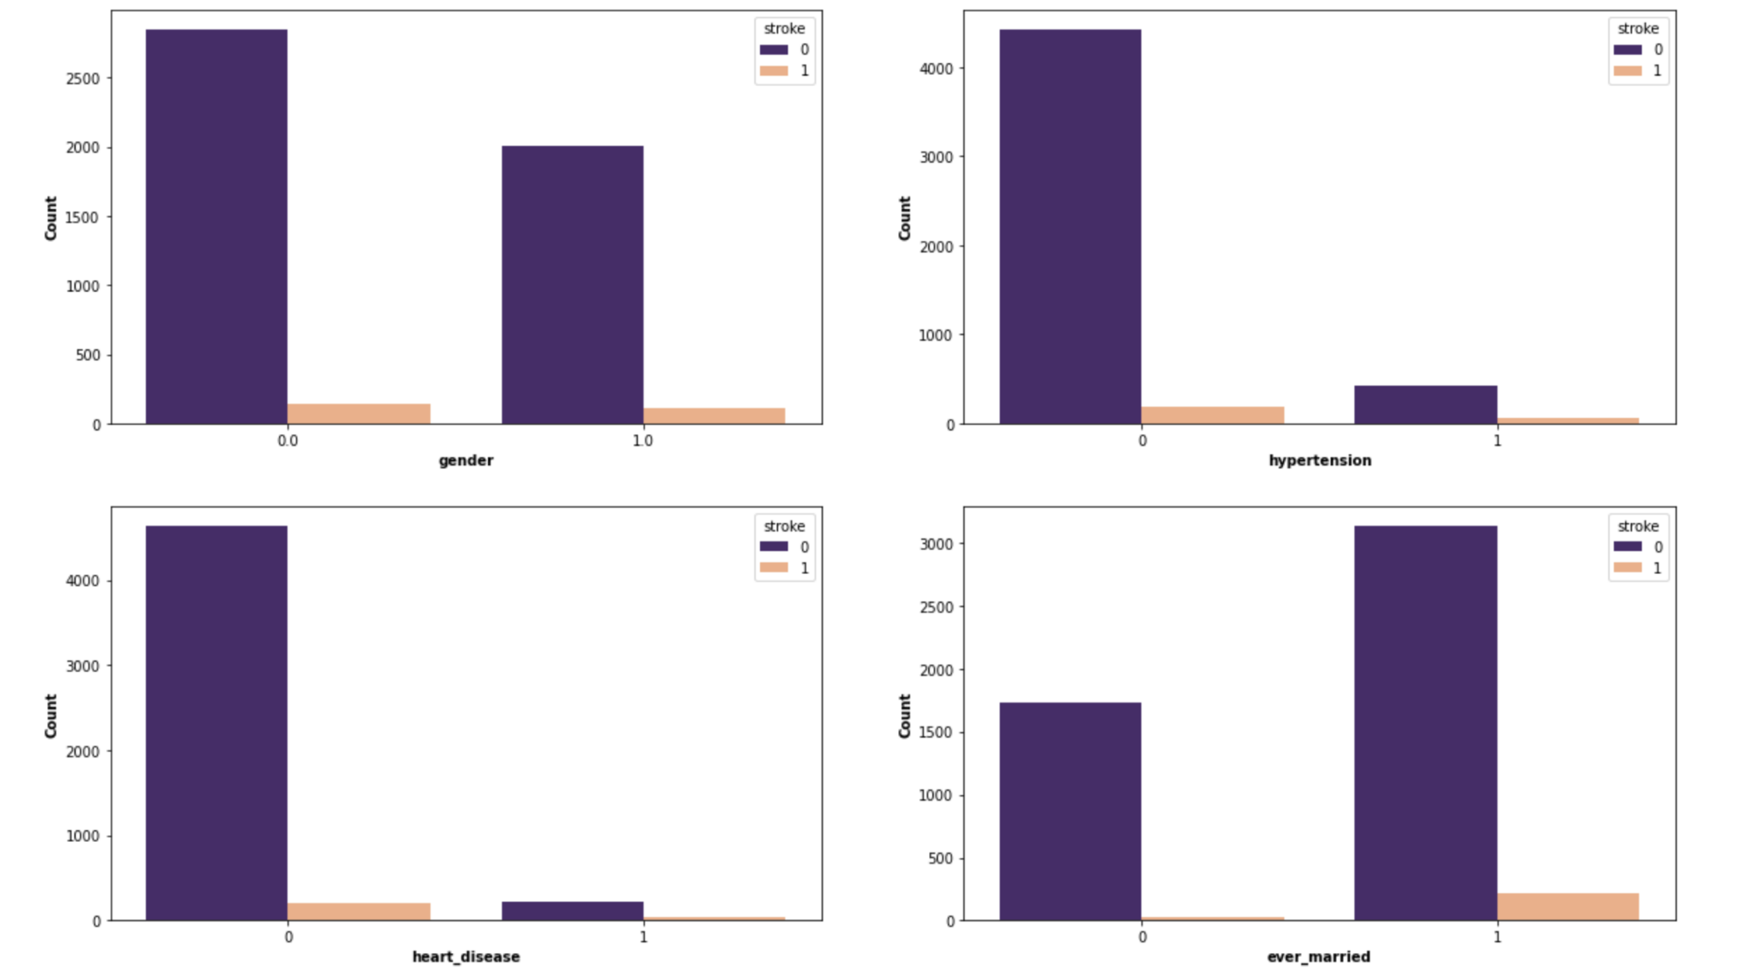
Data Visualization

Slide 7
Results
K-nearest Neighbors - 95%
Random Forest - 95%
Decision Tree - 91%
Naive Bayes - 85%

Slide 8
References
NCBI. Prediction and Control of Stroke by Data Mining. Retrieved December 11, 2021, from https://www.ncbi.nlm.nih.gov/pmc/articles/PMC3678226/
Research gate. Prediction of Stroke Using Data Mining Classification Techniques. Retrieved December 11, 2021, from https://www.researchgate.net/publication/322874325_Prediction_of_Stroke_using_Data_Mining_Classification_Techniques
IEEE. Mortality Prediction Using Data Mining Classification Techniques in Patients With Hemorrhagic Stroke. Retrieved December 11, 2021, from https://ieeexplore.ieee.org/document/9268802
CDC. Stroke. Retrieved December 11, 2021, from https://www.cdc.gov/stroke/facts.htm
World Stroke. Why Stroke Matters. Retrieved December 11, 2021, from https://www.world-stroke.org/world-stroke-day-campaign/why-stroke-matters/learn-about-stroke

